Slide 1

INTRODUCTION TO AI(AI101B) Even Semester Session 2024-25
STUDENT PERFORMANCE PREDICTION
SHANTANU YADAV(202410116100193)
SONAM DOBRIYAL(202410116100210)
SHIVAM CHATURVEDI(202410116100198)
VINEET KUMAR(202410116100246)
Project Supervisor:
Ms. Komal Salgotra
Assist. Professor

Slide 2
Content
Introduction
Objective
Methodology
Code
Outcomes
References
Notes:
Font Styles: Times New Roman + Font Size: 25

Slide 3
Introduction
In today’s fast-evolving educational landscape, predicting student performance using artificial intelligence (AI) has proved to be an essential tool for educators and institutions. By implementing AI in student performance prediction, this project aims to enhance the educational system by providing valuable insights to teachers, parents, and administrators. The ability to predict academic outcomes can lead to improved student support, better resource allocation, and more informed decision-making. Ultimately, this project contributes to the broader goal of using technology to foster academic excellence and ensure that every student receives the guidance they need to succeed.
Notes:
Font Styles: Times New Roman + Font Size: 25

Slide 4
Objective of the Project
This project aims at providing insights on how likely a student is going to pass or fail an examination. The project follows a systematic approach, starting with data collection and preprocessing to ensure the accuracy and reliability of the dataset. Feature selection techniques will be applied to identify the most influential factors affecting student performance. Machine learning algorithm, Random Forest Classifier has been implemented. Accuracy of the model will be used to assess its effectiveness.
Notes:
Font Styles: Times New Roman + Font Size: 25

Slide 5
Methodology
Data Collection : Gather student data, like academic records, attendance,
assignments, extracurricular activities, and socio-economic factors.
Data Preprocessing : Clean dataset and handle missing values (if any)
Feature Selection and Engineering : Create meaningful features for better prediction.
Model Selection and Training: Train machine learning model here random forest classifier.
Model Evaluation: Access model performance like accuracy.
Notes:
Font Styles: Times New Roman + Font Size: 25

Slide 6
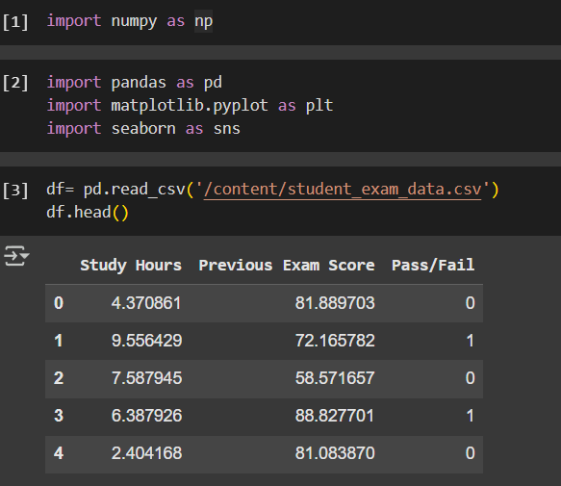
Code
Loading and exploring Dataset
Notes:
Font Styles: Times New Roman + Font Size: 25

Slide 7
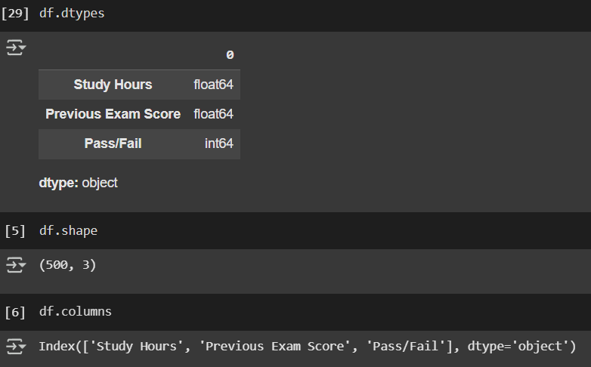

Slide 8
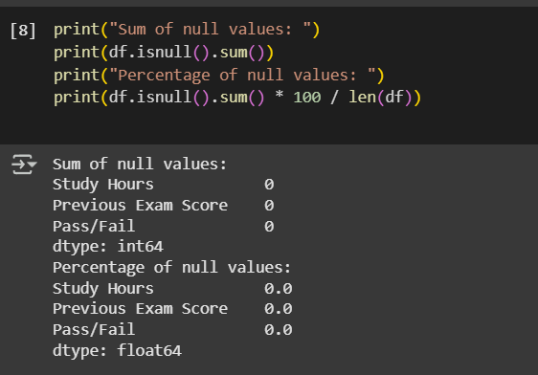
Check for missing values and Handle missing value

Slide 9
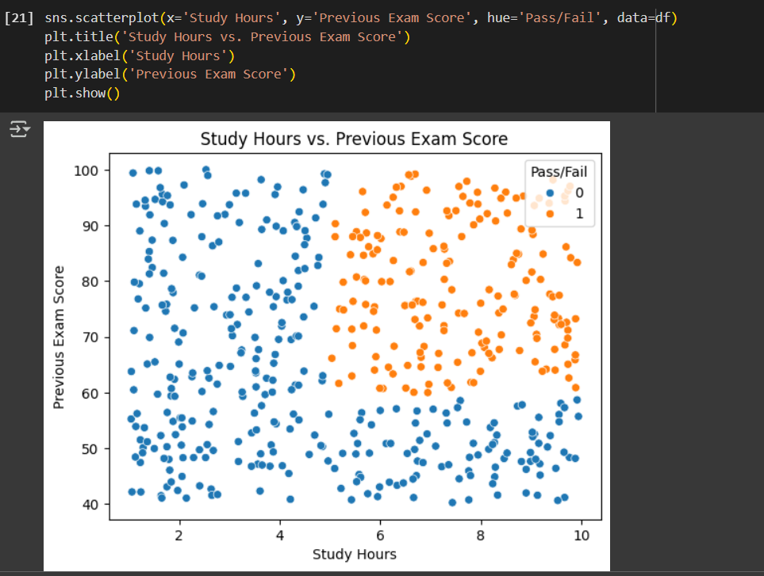
Relationship between Study Hours and Previous Exam Score

Slide 10
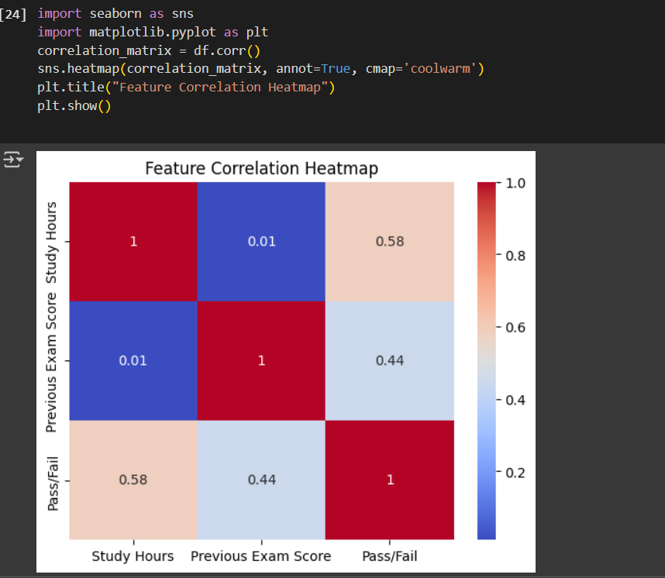
Feature Correlation Heatmap

Slide 11
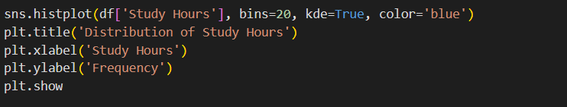
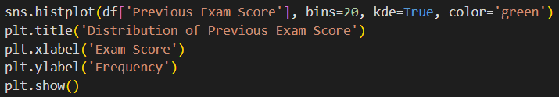
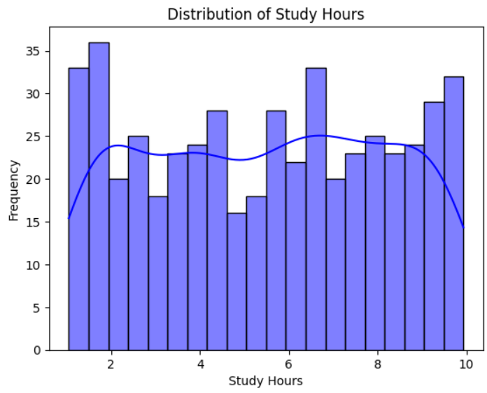
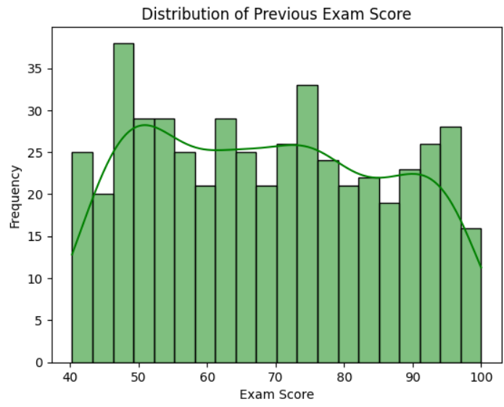

Slide 12


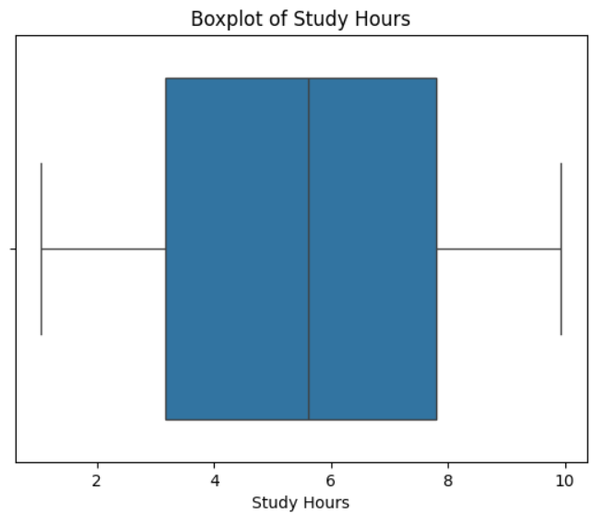
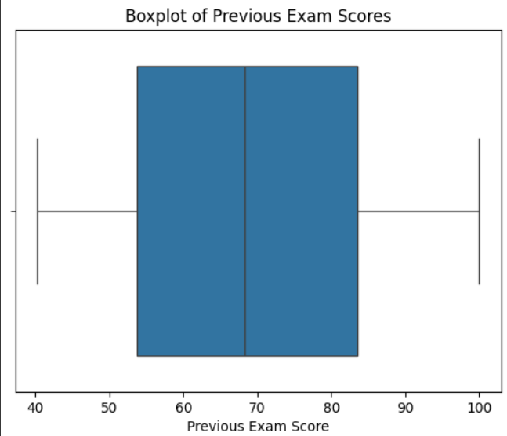

Slide 13
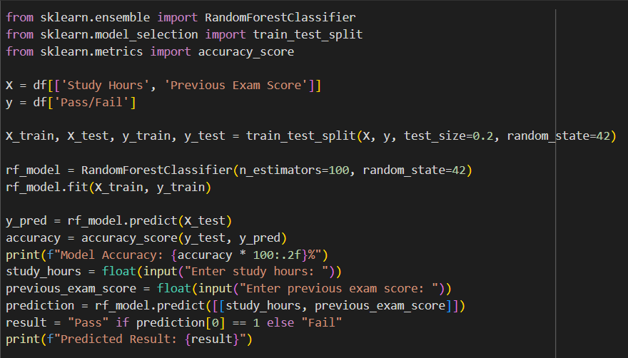

Slide 14
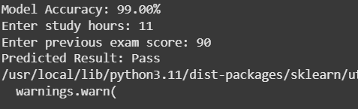
Output

Slide 15
Outcome
Educational institutions can predict their student performance for implementing strategies to enhance their student’s academic performance.
Notes:
Font Styles: Times New Roman + Font Size: 25

Slide 16
References
Kaggle Dataset:
https://www.kaggle.com/code/mdismielhossenabir/student-exam-performance-prediction/input
Notes:
Font Styles: Times New Roman + Font Size: 25

